Slide 1



arkest
So schnell Parkest du noch nie!

Slide 2




Munich Parking: Losses Per Driver
26%
50 hrs
€1.092
Trip time lost to parking search
Annual search time
Annual cost

Slide 3
Losses For Munich
126kg CO₂
€1,1 bn.
Annual extra emissions per driver
Annual costs for Munich
Notes:
sustainability goal for the City of Munich is to become climate-neutral by 2035, aligning with the EU's "100 climate-neutral cities" initiative. This goal is supported by various initiatives across the city, including Stadtwerke München aiming to generate enough renewable electricity for the city by 2025 and achieve CO₂-neutral district heating by 2040.
… So naturally our goal is to minimize that time.

Slide 4
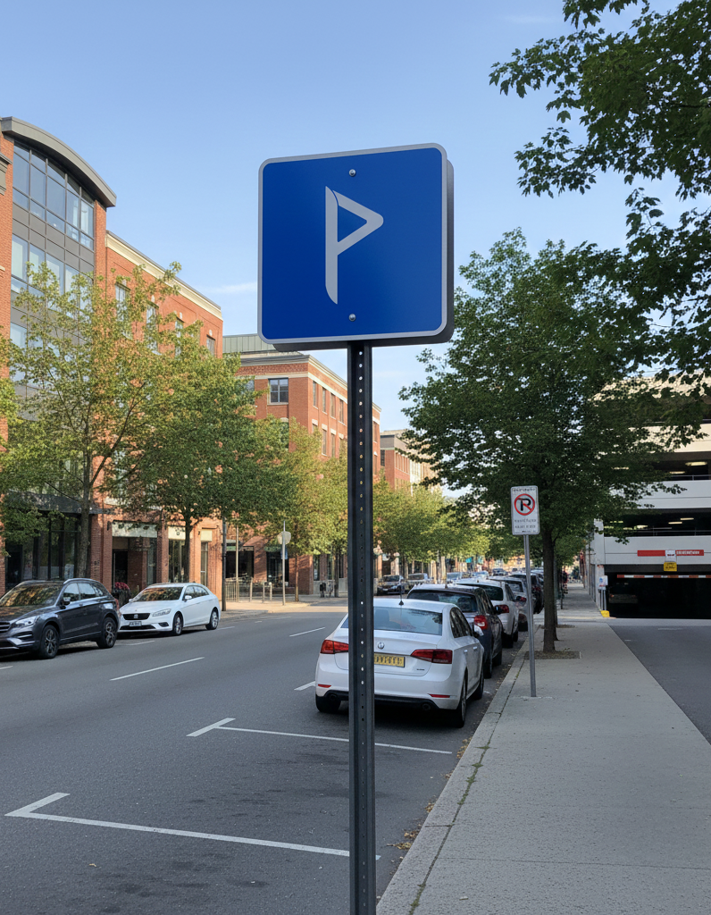
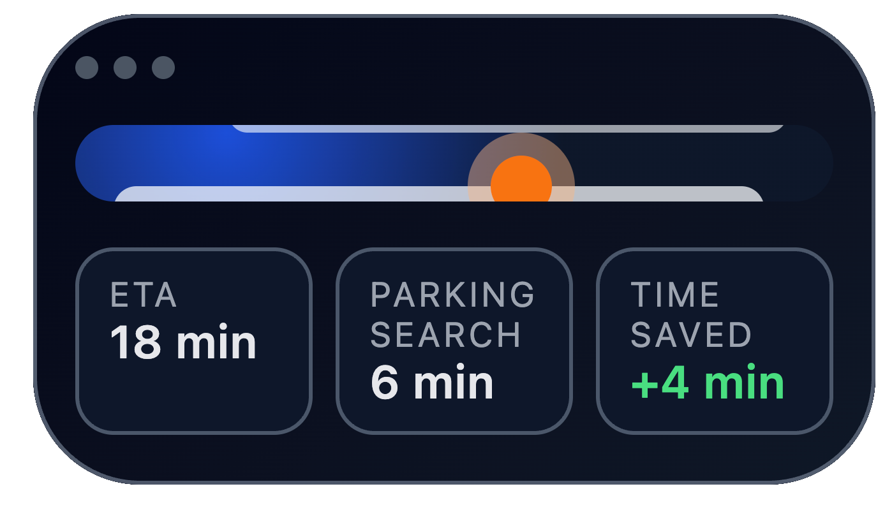
Best Parking Estimation
Notes:
This lead us to create our best park

Slide 5
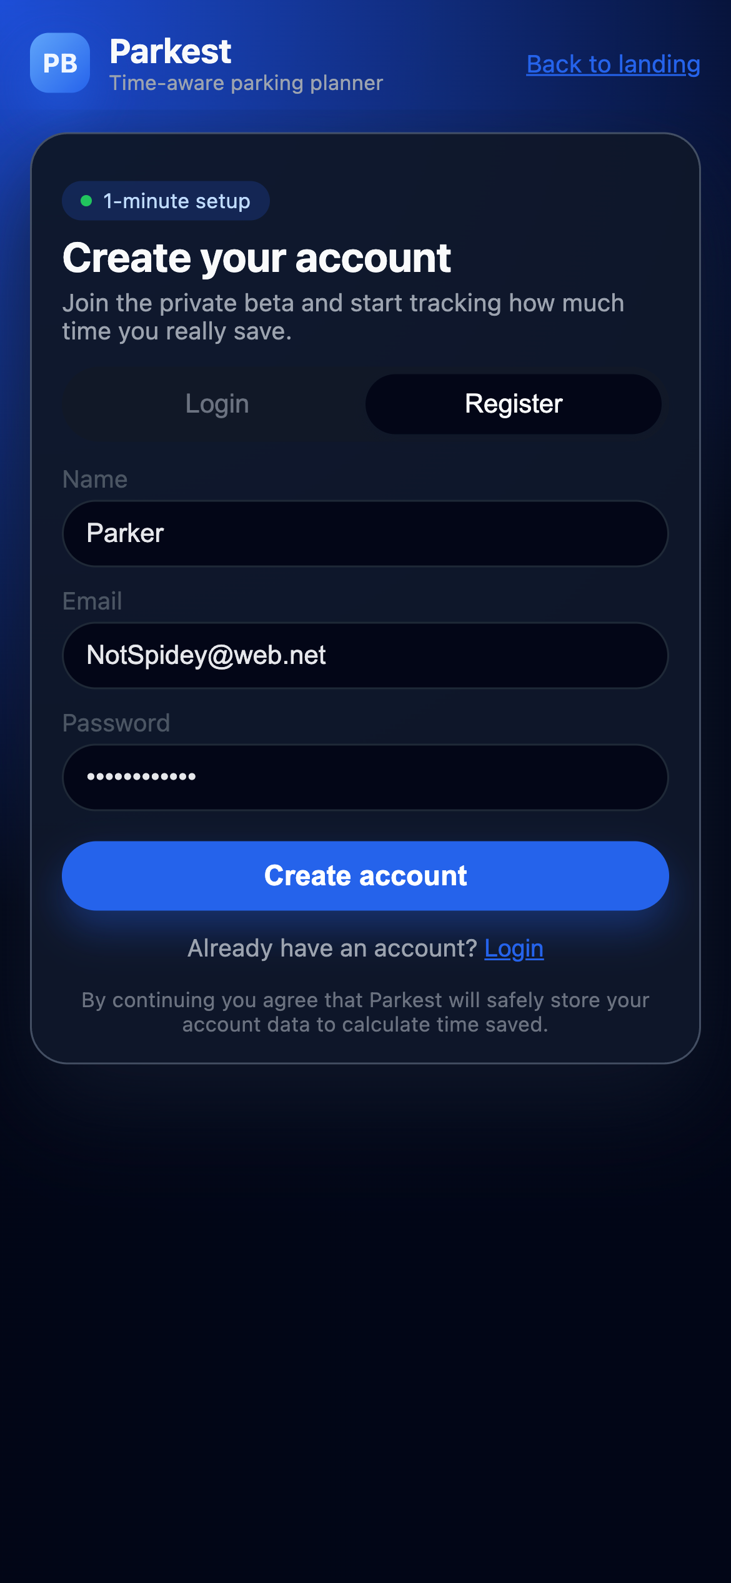
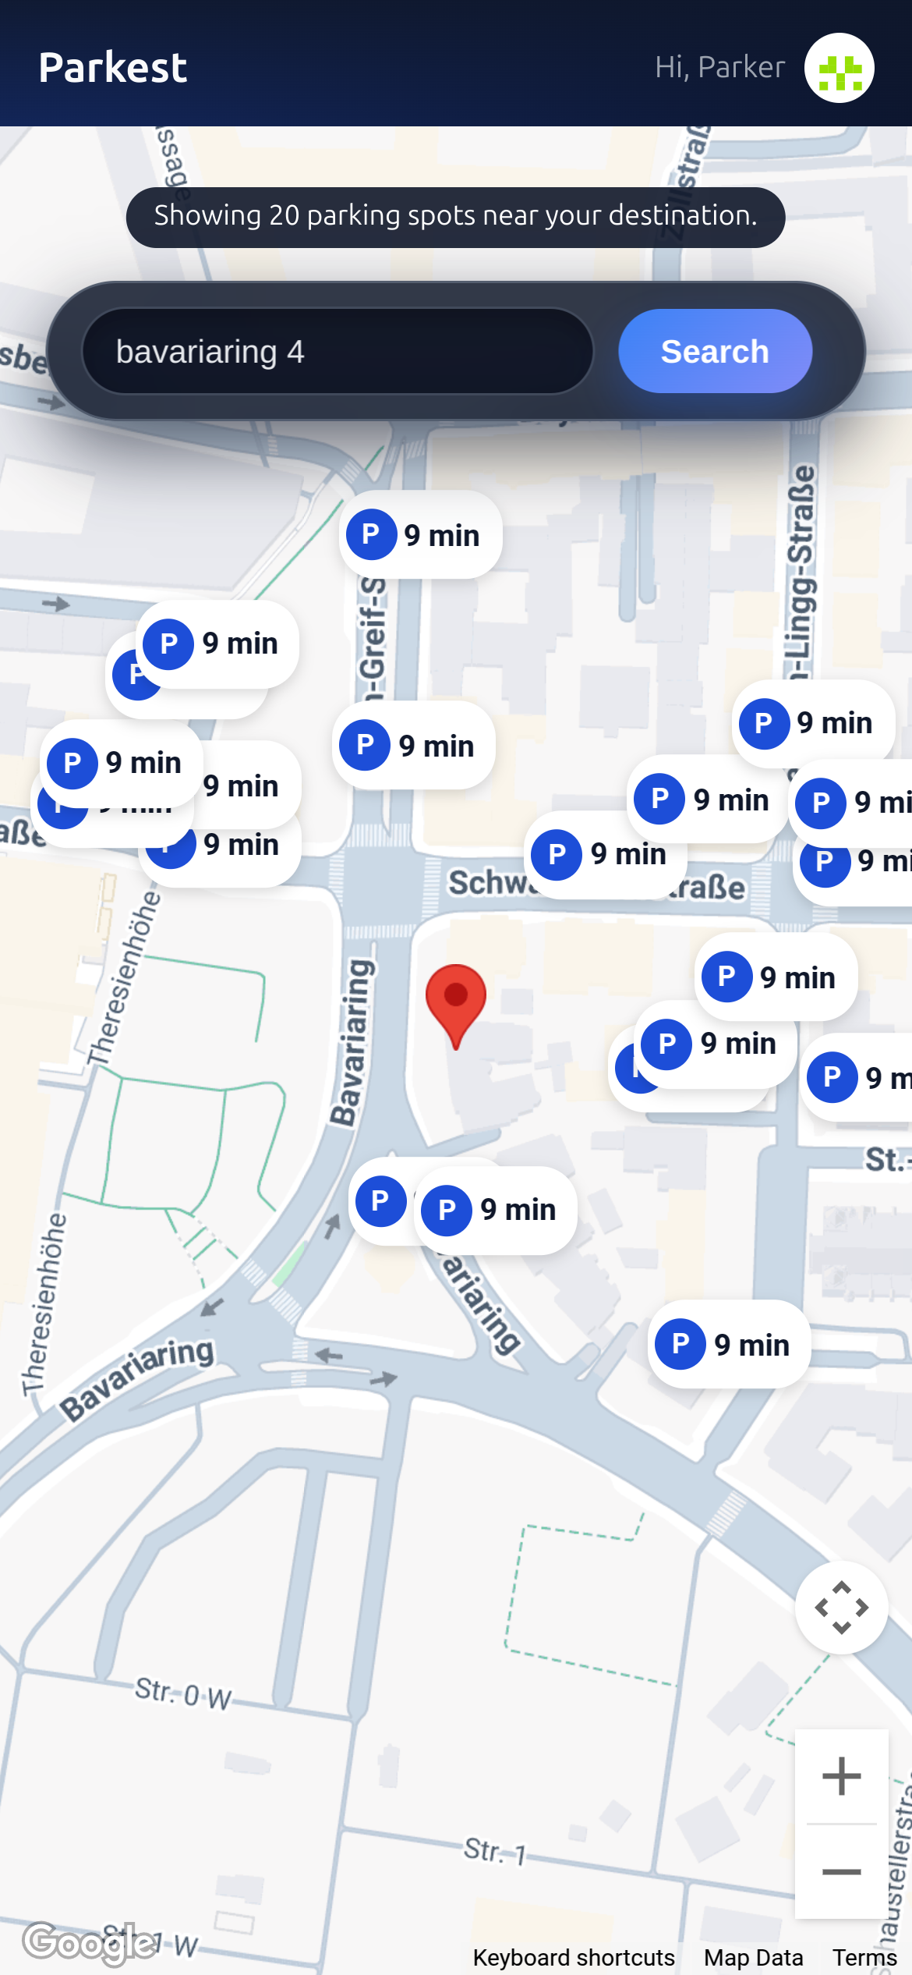
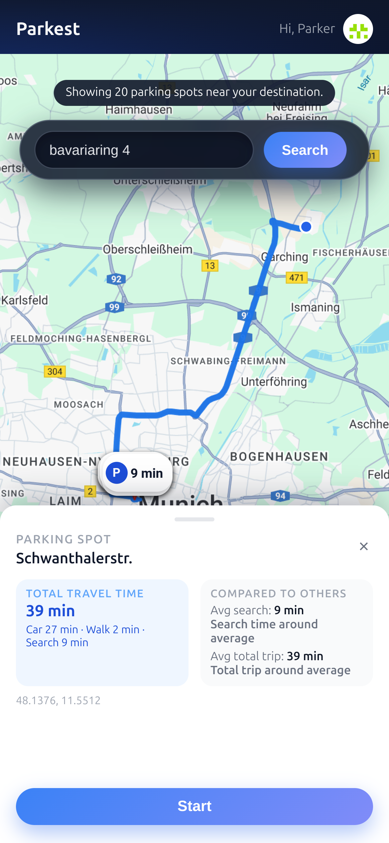
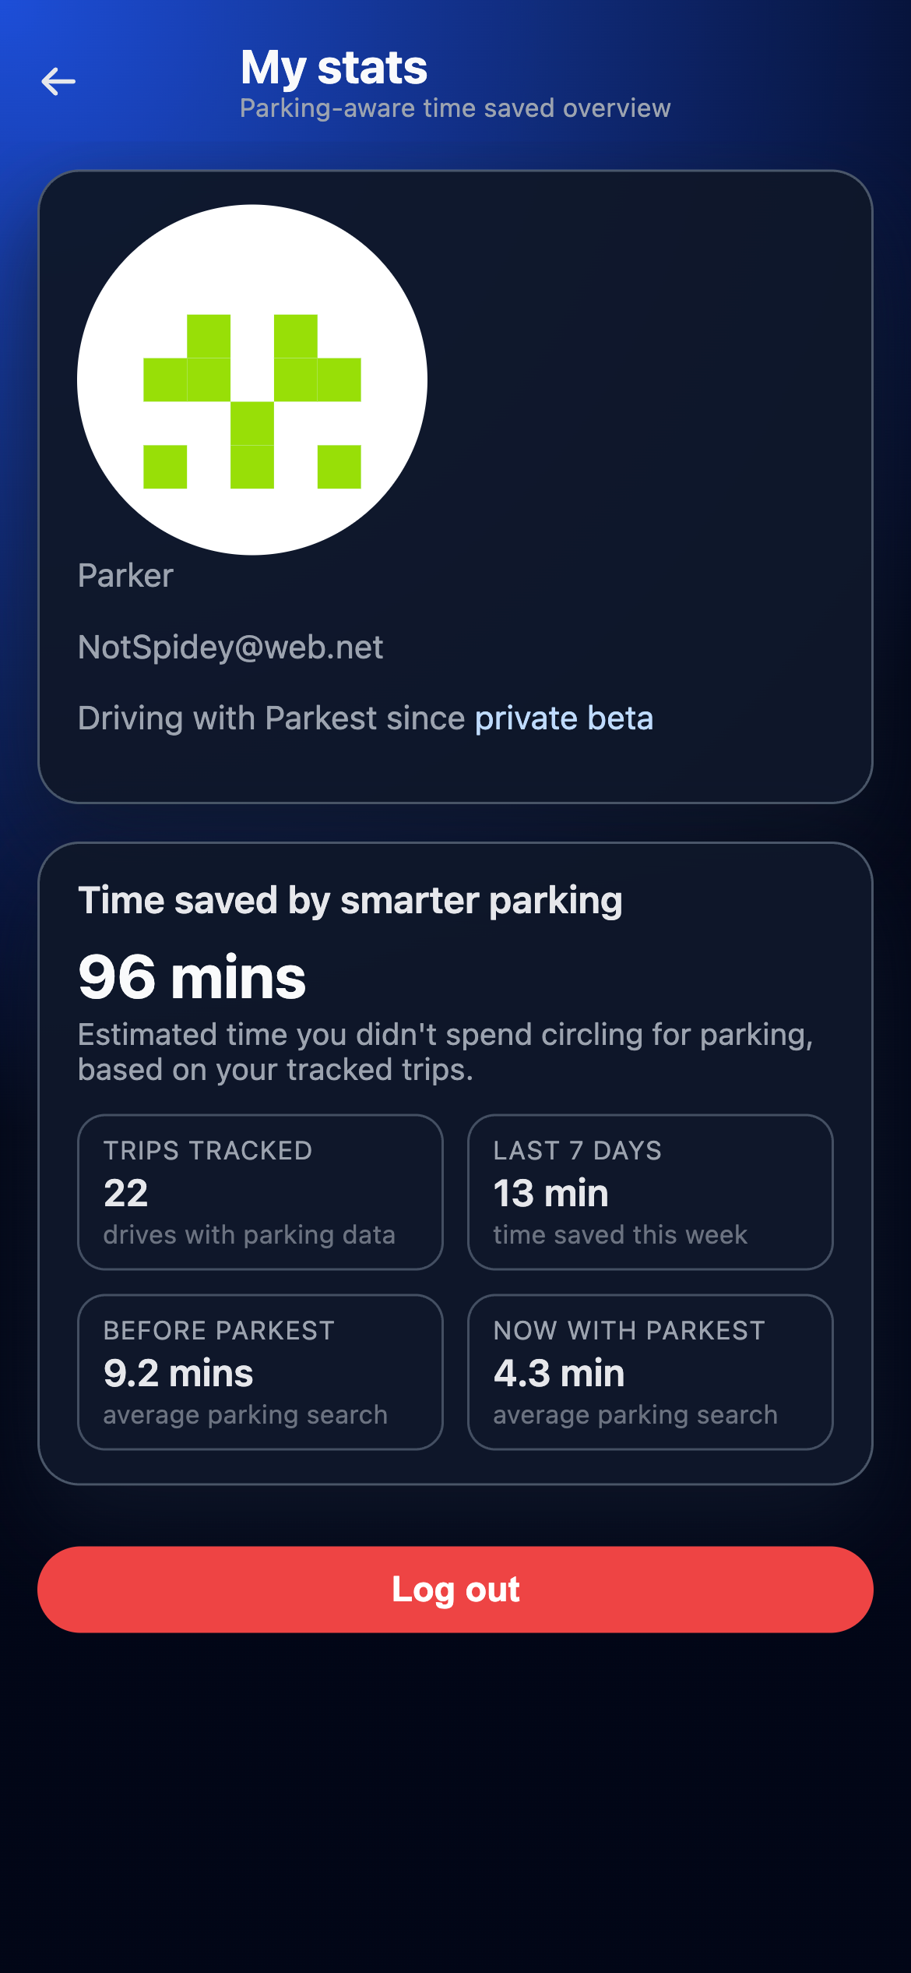
App Overview

Slide 6
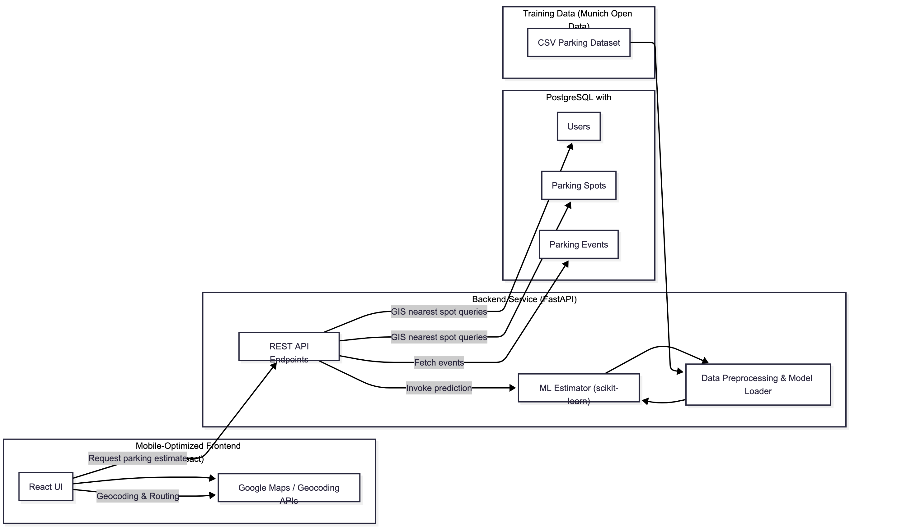






System Design

Slide 7
The Future For Parkest
Gamification: Save Time
Dynamic
Pricing
Benefits
System
Optimize
Prediction
Pipeline

Slide 8
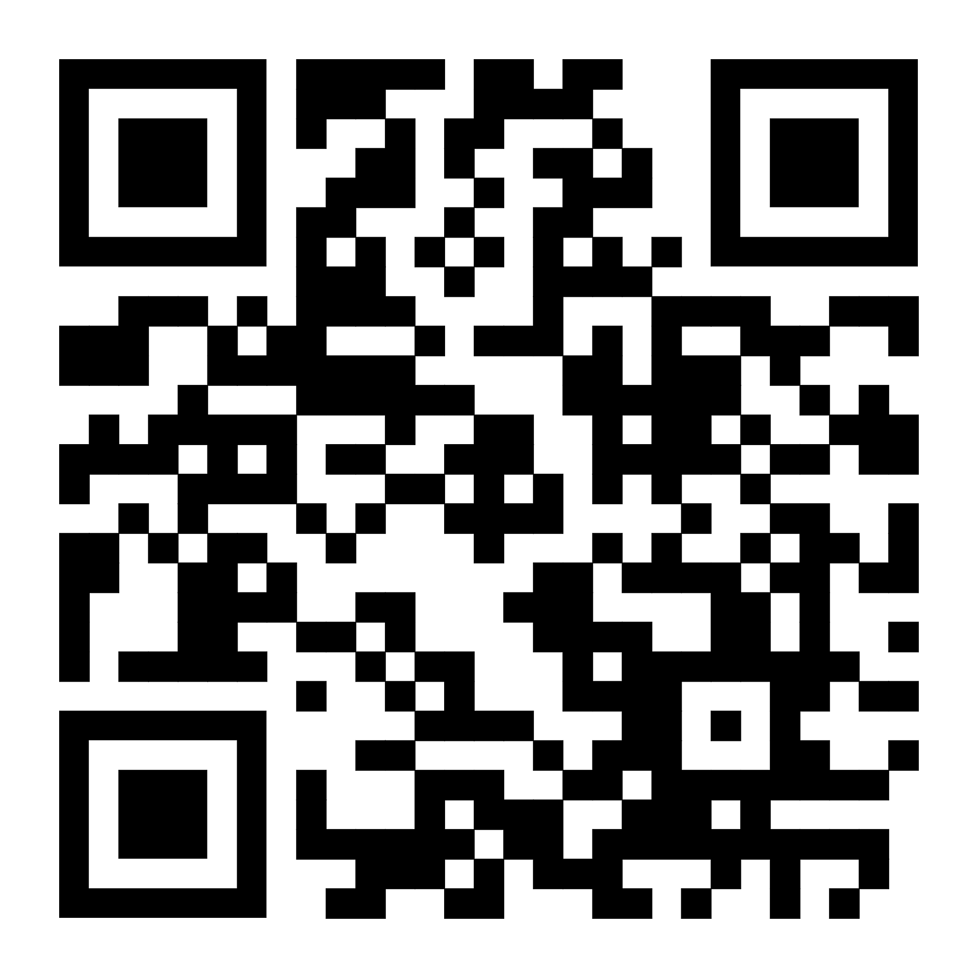
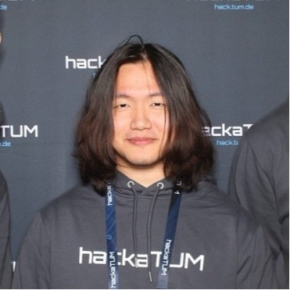
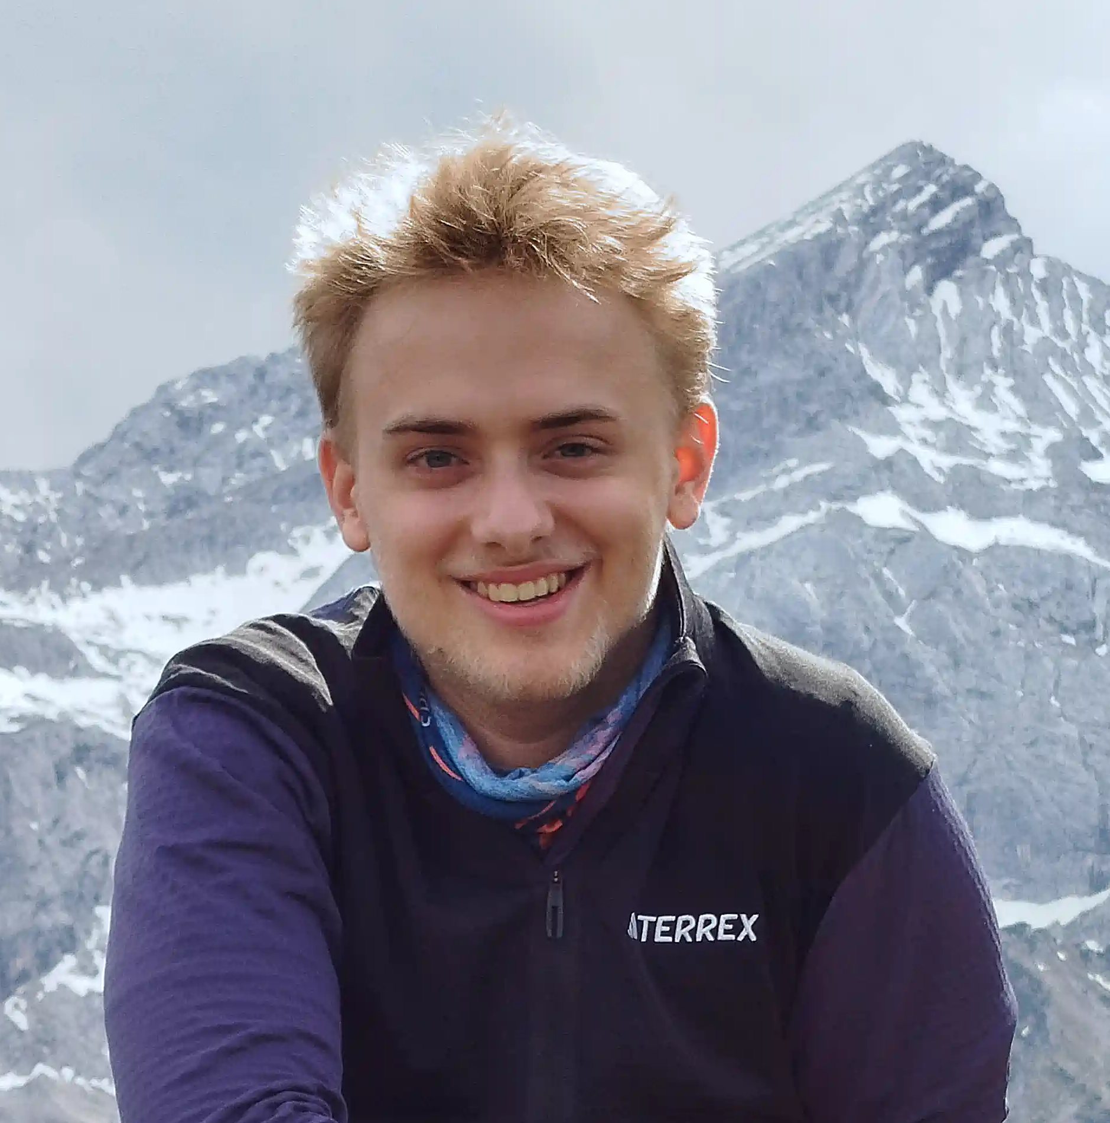
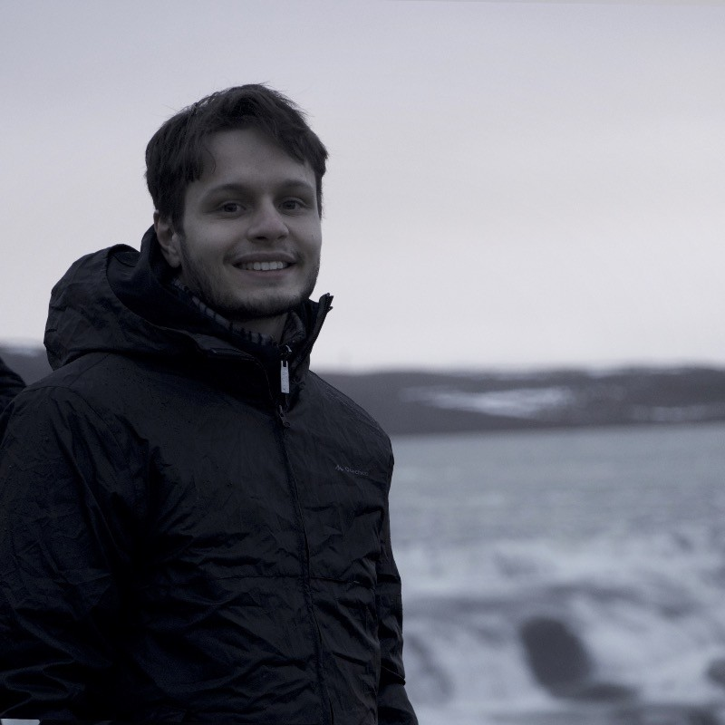

Check Out Parkest!
Men Seng Qiu
Mauritz Orlinski
Matteo Feliziani
Ahmed Ramadan

